Slide 1
Traineeship 2024 – Powershell

Slide 2


Xavier Clinquart
Who am i?
Xavier.clinquart@axxes.com
Working with Axxes since December 2014
Senior system everything @ Groven +
In love with Automation
Proud member of the Axxes Powershell PACMAN Club
Organiser of the BEPUG Usergroup

Slide 3

Dieter De Smet
Who am i?
Dieter.desmet@axxes.com
Working with Axxes since October 2018
Senior system engineer @ Regie der gebouwen back office engineer
In love with Automation and Home Automation
Proud member of the Axxes Powershell PACMAN Club

Slide 5

Contents
Choose your tools
Finding information and help
Understanding commands
The Pipeline
Actual scripting
Error handling
Logging
Modules
Active Directory Module
Notes:
HELP, ERROR, Understanding commands, LOGGING – Dieter
Tools, Pipeline, Actual, Modules,AD - Xavier

Slide 6
Choose your tools
Command line , Windows Terminal
PowerShell ISE
Visual Studio Code
Other IDE’s (Visual studio , notepad++, …)

Slide 7
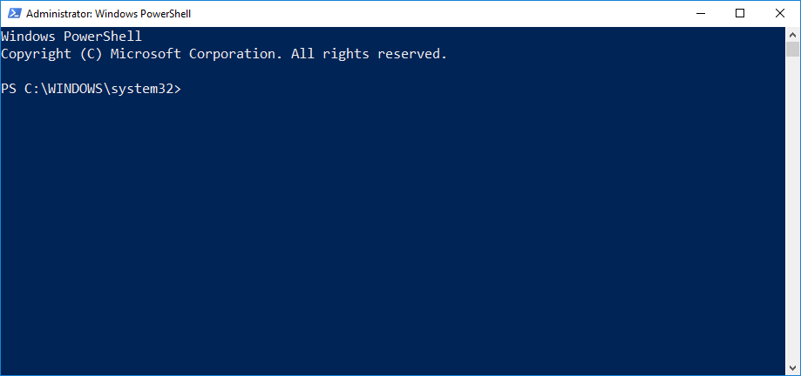
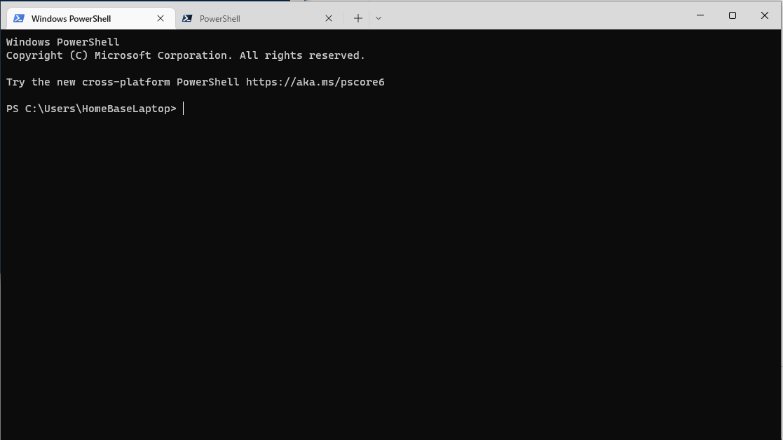
Command line shell
Excellent for quick commands
Limited in tab completion
Not OK for scripting
Terminal : Easy access to different versions

Slide 8
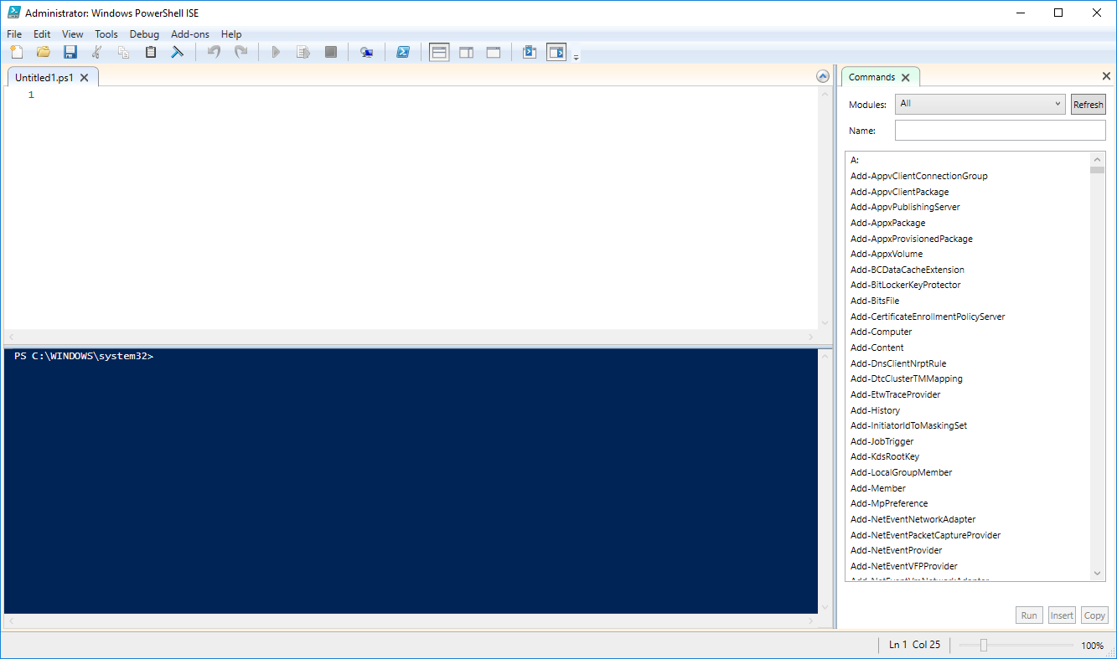
PowerShell ISE
No longer developed by Microsoft
IntelliSense + Tab completion
Debug functions
Add-ons
Good for scripting
Still used by many Dev’s

Slide 9
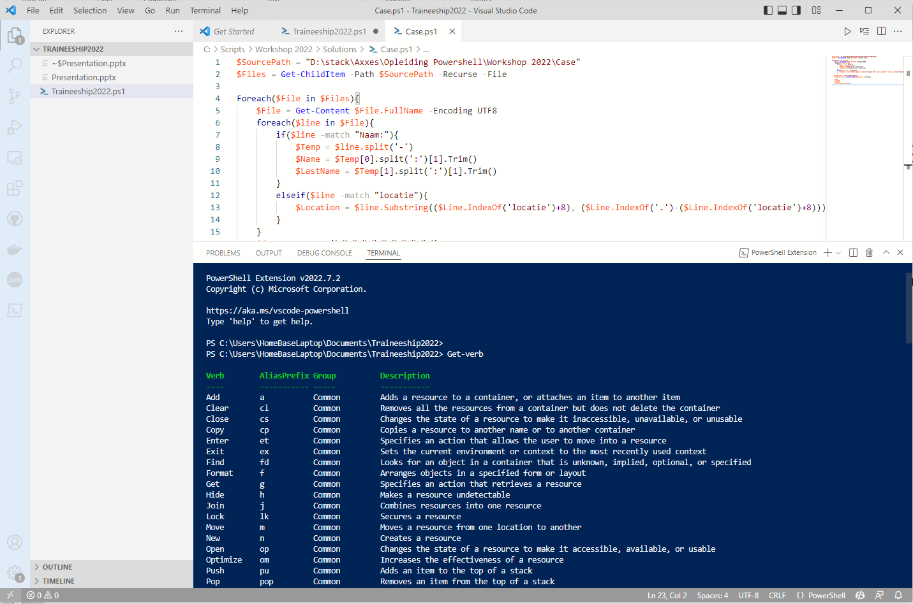
Visual Studio Code
Advised choice by Microsoft
Tons of Extensions
IntelliSense
GIT Support
Easy to manage bigger projects
Platform independent

Slide 10
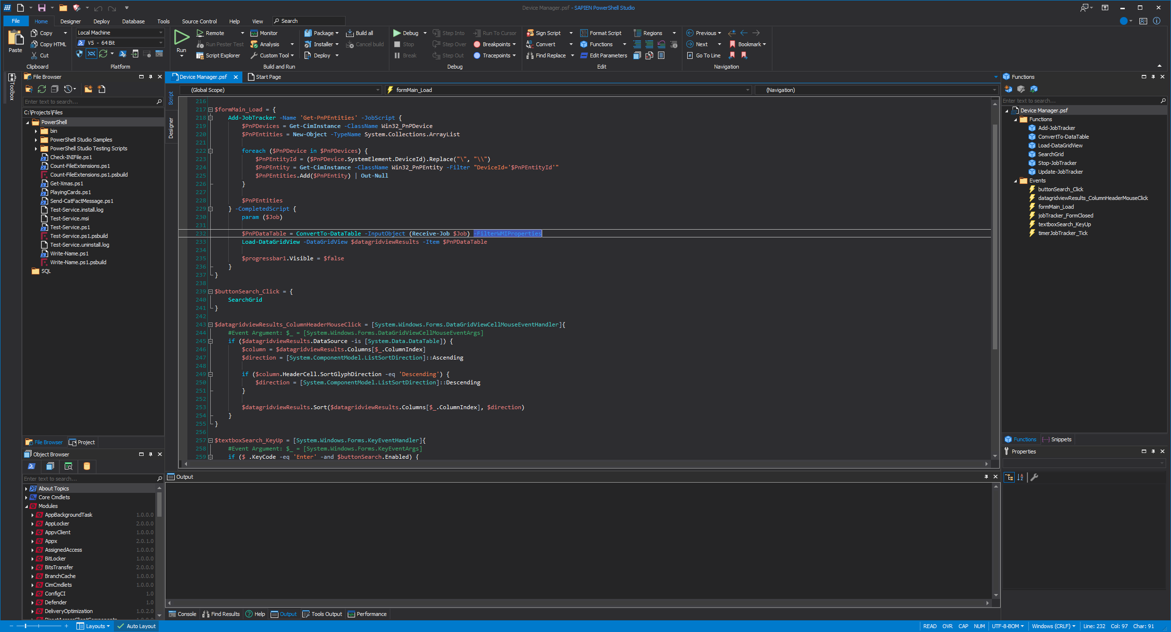
Other IDE’s
2 categories
Paying:
Visual Studio
Sapien PowerShell Studio 2024
Free
Notepad.
++
Notes:
https://www.sapien.com/software/powershell_studio

Slide 11
PS 7 – Why would I upgrade?
Powershell 7.4 (7.5 in Preview)
Cross-platform (also 5)
Out-gridview also in Linux
Debugging is easier → Stepping debugging possible
Foreach-parallelism → run foreach objects in parallel.
Usage Binary ZIP possible
Ternary operator usage
HashTables with ordered keys
Better compatibility to other Microsoft Products (SQL,Exchange,...)
Better PSReadline (Predictive IntelliSense)

Slide 12
PS 7 – IntelliSense Can also be installed on 5 (For some features, you need to be running PowerShell 7.2 or higher)
Syntax coloring of the command line
A visual indication of syntax errors
A better multi-line experience (both editing and history)
Customizable key bindings
Cmd and Emacs modes
Many configuration options
Bash style completion (optional in Cmd mode, default in Emacs mode)
Emacs yank/kill-ring
PowerShell token based "word" movement and deletion
Predictive IntelliSense
Dynamic display of Help in the console without losing your place on the command line
Predictive IntelliSense
Predictive IntelliSense is an addition to the concept of tab completion that assists the user in successfully completing commands. It enables users to discover, edit, and execute full commands based on matching predictions from the user's history and additional domain specific plugins.

Slide 13

Lets hop over to some code

Slide 14
Finding information and Help

Slide 15
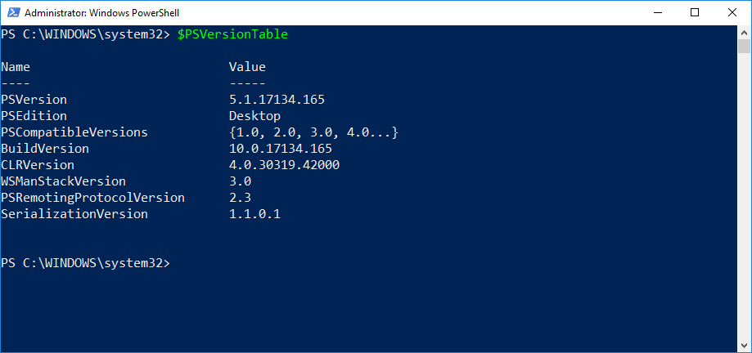
Tab Completion and Intellisense
Tab completion:
Type Get-S in the CMD and press TAB.
Type Dir C:\ and press TAB.
IntelliSense
Tab completion, but with a nice dropdown menu.
Finding your PSversion
$PSVersionTable
get-host | select-object version

Slide 16
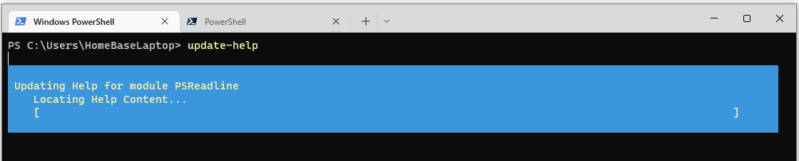
The Get-Help command
Built in help function
Requires update (run as admin)
Get-help

Slide 17
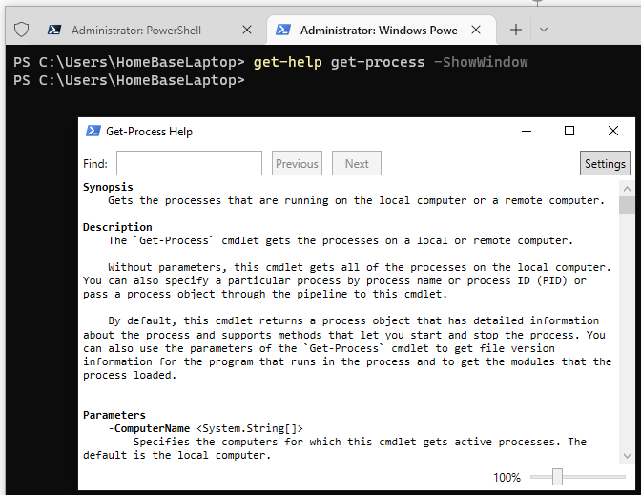
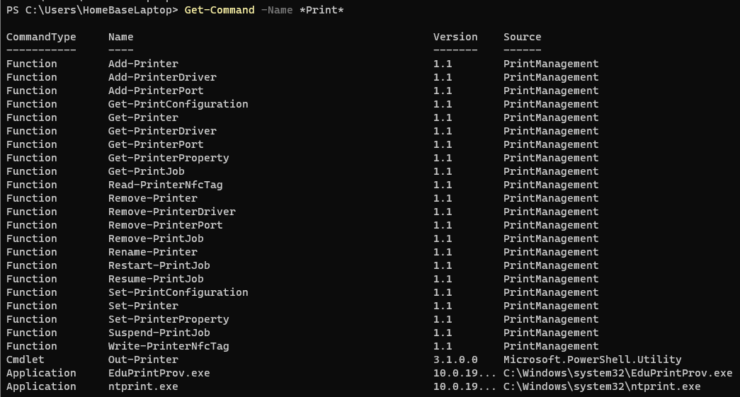
Find help for commands
Commands -> -showWindow
-Online , -Full , -Example
Get-command to find commands
Show-command

Slide 18
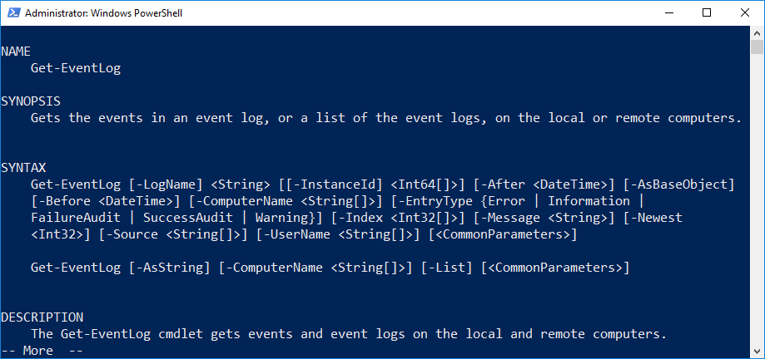
Interpreting Get-help output
Syntax
Multiple syntaxes, multiple parameter sets
Mutually exclusive
Optional parameters
Mandatory parameters
Positional parameters

Slide 19
Optional and Mandatory parameters
Optional parameter in square brackets.
[-ComputerName <String[]>]
Mandatory parameters not in square brackets.
[-LogName] <String>
Will be prompted for if you do not specify.

Slide 20
Positional Parameters
Commonly used parameters.
Not required to type them out.
Example: [-LogName] <String> [[-InstanceID] <Int64[]>]
-LogName is not optional, no square brackets surrounding both name and value.
-LogName is surrounded by square brackets, making it positional.
-InstanceID is optional, both name and value surrounded by square brackets.
-InstanceID is positional, because it is surrounded by square brackets.

Slide 21
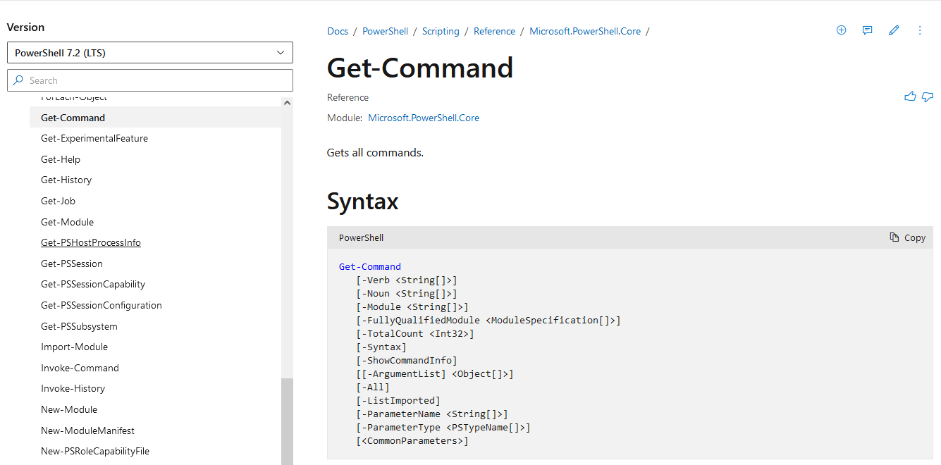
Online Help
Microsoft Docs
Google , Bing , DuckDuckGo , …
https://github.com/PowerShell

Slide 22
Labo

Slide 23
Understanding commands

Slide 24
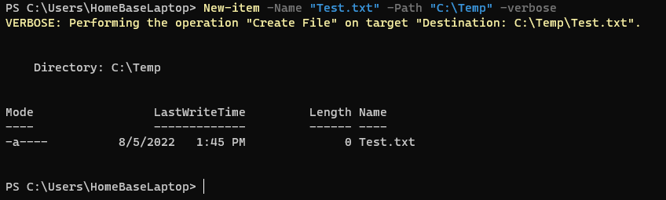
The anatomy of a command
Command
Name: New-item
Parameter 1
Name: -Name
Value: “Test.txt”
Parameter 2
Name: -Path
Values: “C:\Temp”
Parameter 3
Switch parameter
Name: -verbose , -whatif

Slide 25
Aliases
Alias: short nickname
“gsv” instead of “Get-Service”.
Get-Alias
Get-Alias –Definition Get-Services
New-Alias
Not advised for sharing

Slide 26
Wildcards
Most of the “item” cmdlets include the –Path property.
* -> a*
? -> ?n
[ ] -> [a-e]calc or [alz]calc
Wildcards are allowed here.
Example: Get-item –Path C:\*.exe
Cancel out Wildcard
`* -> `?

Slide 27
Output of commands
Direct variable
Object
Get-Member

Slide 28
The Pipeline

Slide 29
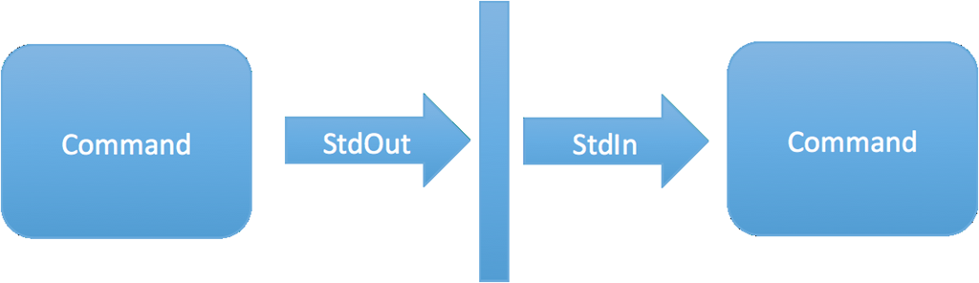
The Pipeline
Use output as input
Not on all commands
Sorting , Filtering
Looping

Slide 30
Some Code

Slide 31
Actual Scripting

Slide 32

Variables

Slide 33
Statements
If else elseif
Switch case
While
Do while
Foreach
For

Slide 34
Logical Operators
-eq
-ne
-ge
-le
-lt
-gt
-AND
-OR
-NOT , !
++ , --

Slide 35
Input and output
Read-host
Write-host
Out-default
Write-Output
Get-Content
Out-file
Clear-host

Slide 36
Functions
Definition
Parameters
Return value

Slide 37
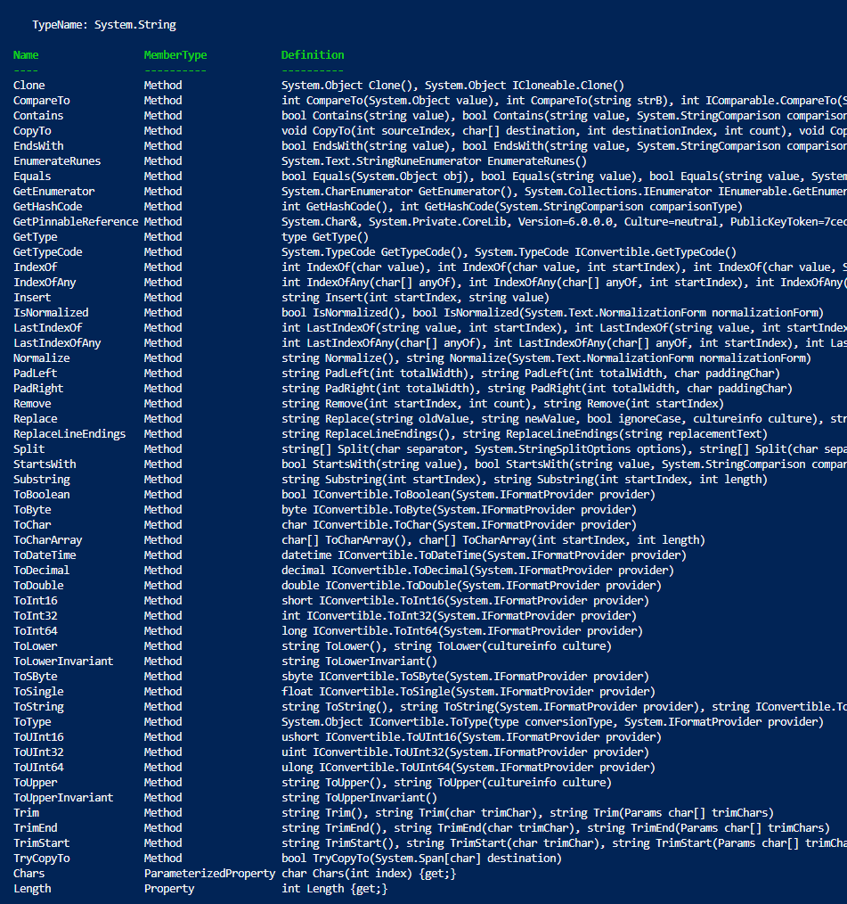
Text manipulations
Conversions
Replace
Splitting
Removing
Trimming
Substrings
Searching/compairing

Slide 38
Labo

Slide 39
Error handling

Slide 40
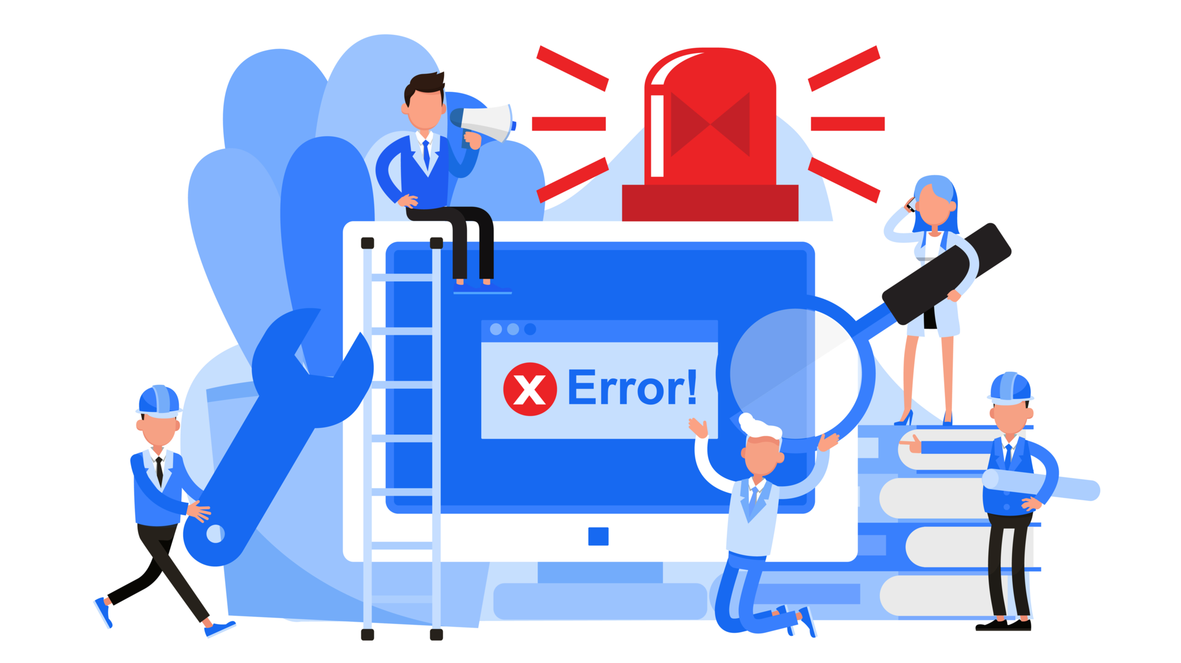
Error handling
Try , catch , Finally
Filtering on exceptions
Triggering contingency’s
Exception list

Slide 41
Lets hop over to some code

Slide 42
Logging

Slide 43

Logging
Data
Outcome
Out-file
PsTranscript

Slide 44
Inline Logging/debugging
6 Streams
Success stream
Error stream
Warning stream
Verbose stream
Debug stream
Information stream
(Progress stream)

Slide 45
Lets hop over to some code

Slide 46
Modules

Slide 47

Modules getting started
What
Why
How to get
How to create

Slide 48
Lets hop over to some code

Slide 49
Active Directory Module

Slide 50
What can you manage
Users
Groups
Computer objects
OU’s
Trusts
…

Slide 51
Why would you use it
Repeatable
No human error
Execute mass change in one go

Slide 52
Reporting
Create output based on filters
Any attribute
Good filtering = Win in Time/Performance
Filter as soon as possible

Slide 53
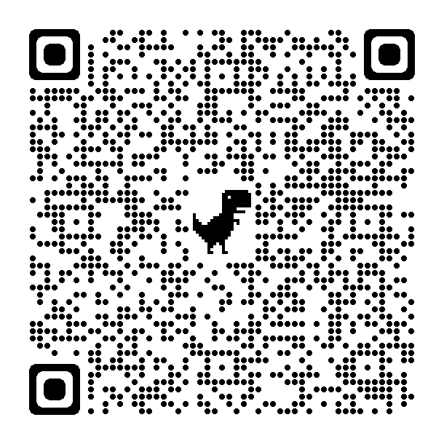

Questions + Use Case (If we have time ! Or if you really really really want to)

